Slide 1
Chapter 19: Architecturally Significant Requirements
The most important single aspect of software development is to be clear about what you are trying to build. —Bjarne Stroustrup

Slide 2
Chapter Outline
Gathering ASRs from Requirements Documents
Gathering ASRs by Interviewing Stakeholders
Gathering ASRs by Understanding the Business Goals
Capturing ASRs in a Utility Tree
Change Happens
Summary

Slide 3
Gathering ASRs
Architectures exist to build systems that satisfy requirements.
Not all requirements are created equal.
Some have a profound effect on the architecture than others: architecturally significant requirements (ASRs).
You cannot hope to design a successful architecture if you do not know the ASRs.
How do we do this?

Slide 4
Gathering ASRs from Requirements Documents
An obvious location to look for candidate ASRs is in the requirements document or in user stories.
Don't get your hopes up.

Slide 5
Gathering ASRs from Requirements Documents
Many projects don’t have good (or any) requirements document.
And no architect can wait until the requirements are “done” before starting work.
In practice, though, we rarely see adequate capture of QA requirements.
Much of what is useful to an architect won’t be found in even the best requirements document.

Slide 6
Gathering ASRs from Requirements Documents
Some things to look for:
Usage. User roles versus system modes, internationalization, language distinctions.
Time. Timeliness and element coordination.
External elements. External systems, protocols, sensors or actuators (devices),
middleware.
Networking. Network properties and configurations (including their security properties).
Orchestration. Processing steps, information flows.
Security properties. User roles, permissions, authentication.
Data. Persistence and currency.
Resources. Time, concurrency, memory footprint, scheduling, multiple users, multiple activities, devices, energy usage, soft resources (e.g., buffers, queues), scalability requirements.
Project management. Plans for teaming, skill sets, training, team coordination.
Hardware choices. Processors, families of processors, evolution of processors.
Flexibility of functionality, portability, calibrations, configurations.
Named technologies, commercial packages.

Slide 7
Gathering ASRs by Interviewing Stakeholders
Stakeholders often don’t know what their QA requirements actually are. In that case, architects may have to set the QA requirements.
If you insist on quantitative QA requirements, you may get numbers that are arbitrary.
Experienced architects often have deep insights based on similar systems.
Architects can also give feedback as to which QA responses will be straightforward to achieve and which will likely be problematic.

Slide 8
Gathering ASRs by Interviewing Stakeholders
Interviewing the relevant stakeholders is the surest way to learn what they know and need.
The results of stakeholder interviews should include a prioritized list of architectural drivers including QA scenarios.
One such method to do this is the Quality Attribute Workshop (QAW).
The QAW is a facilitated, stakeholder-focused method to generate, prioritize, and refine quality attribute scenarios before the software architecture is completed.

Slide 9
Steps of the QAW
Business/mission presentation.
Architectural plan presentation.
Identification of architectural drivers.
Scenario brainstorming.
Scenario consolidation.
Scenario prioritization.
Scenario refinement.

Slide 10
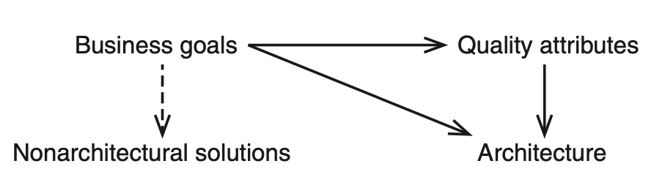
Gathering ASRs by Understanding Business Goals
Business goals are of interest to architects because they frequently lead directly to ASRs.
There are three possible relationships between business goals and an architecture:
Business goals often lead to quality attribute requirements.
Business goals may affect the architecture without inducing a quality attribute requirement at all.
No influence of a business goal on the architecture.

Slide 11
Gathering ASRs by Understanding Business Goals
Categories of business goals:
Growth and continuity of the organization
Meeting financial objectives
Meeting personal objectives
Meeting responsibility to the employees
Meeting responsibility to society
Meeting responsibility to the state
Meeting responsibility to the shareholders
Managing market position
Improving business processes
Managing the quality and reputation of products
Managing change in the environment over time
These categories can be used as an aid to brainstorming and elicitation.

Slide 12
Capturing ASRs in a Utility Tree
Architects can use a construct called a utility tree when the “primary sources” of requirements are not available.
A utility tree is a top-down representation of what you, as architect, believe to be the most important QA-related ASRs.
The leaves of the tree are scenarios that you prioritize along two dimensions: business value and technical risk. Each dimension is scored H/M/L.

Slide 13
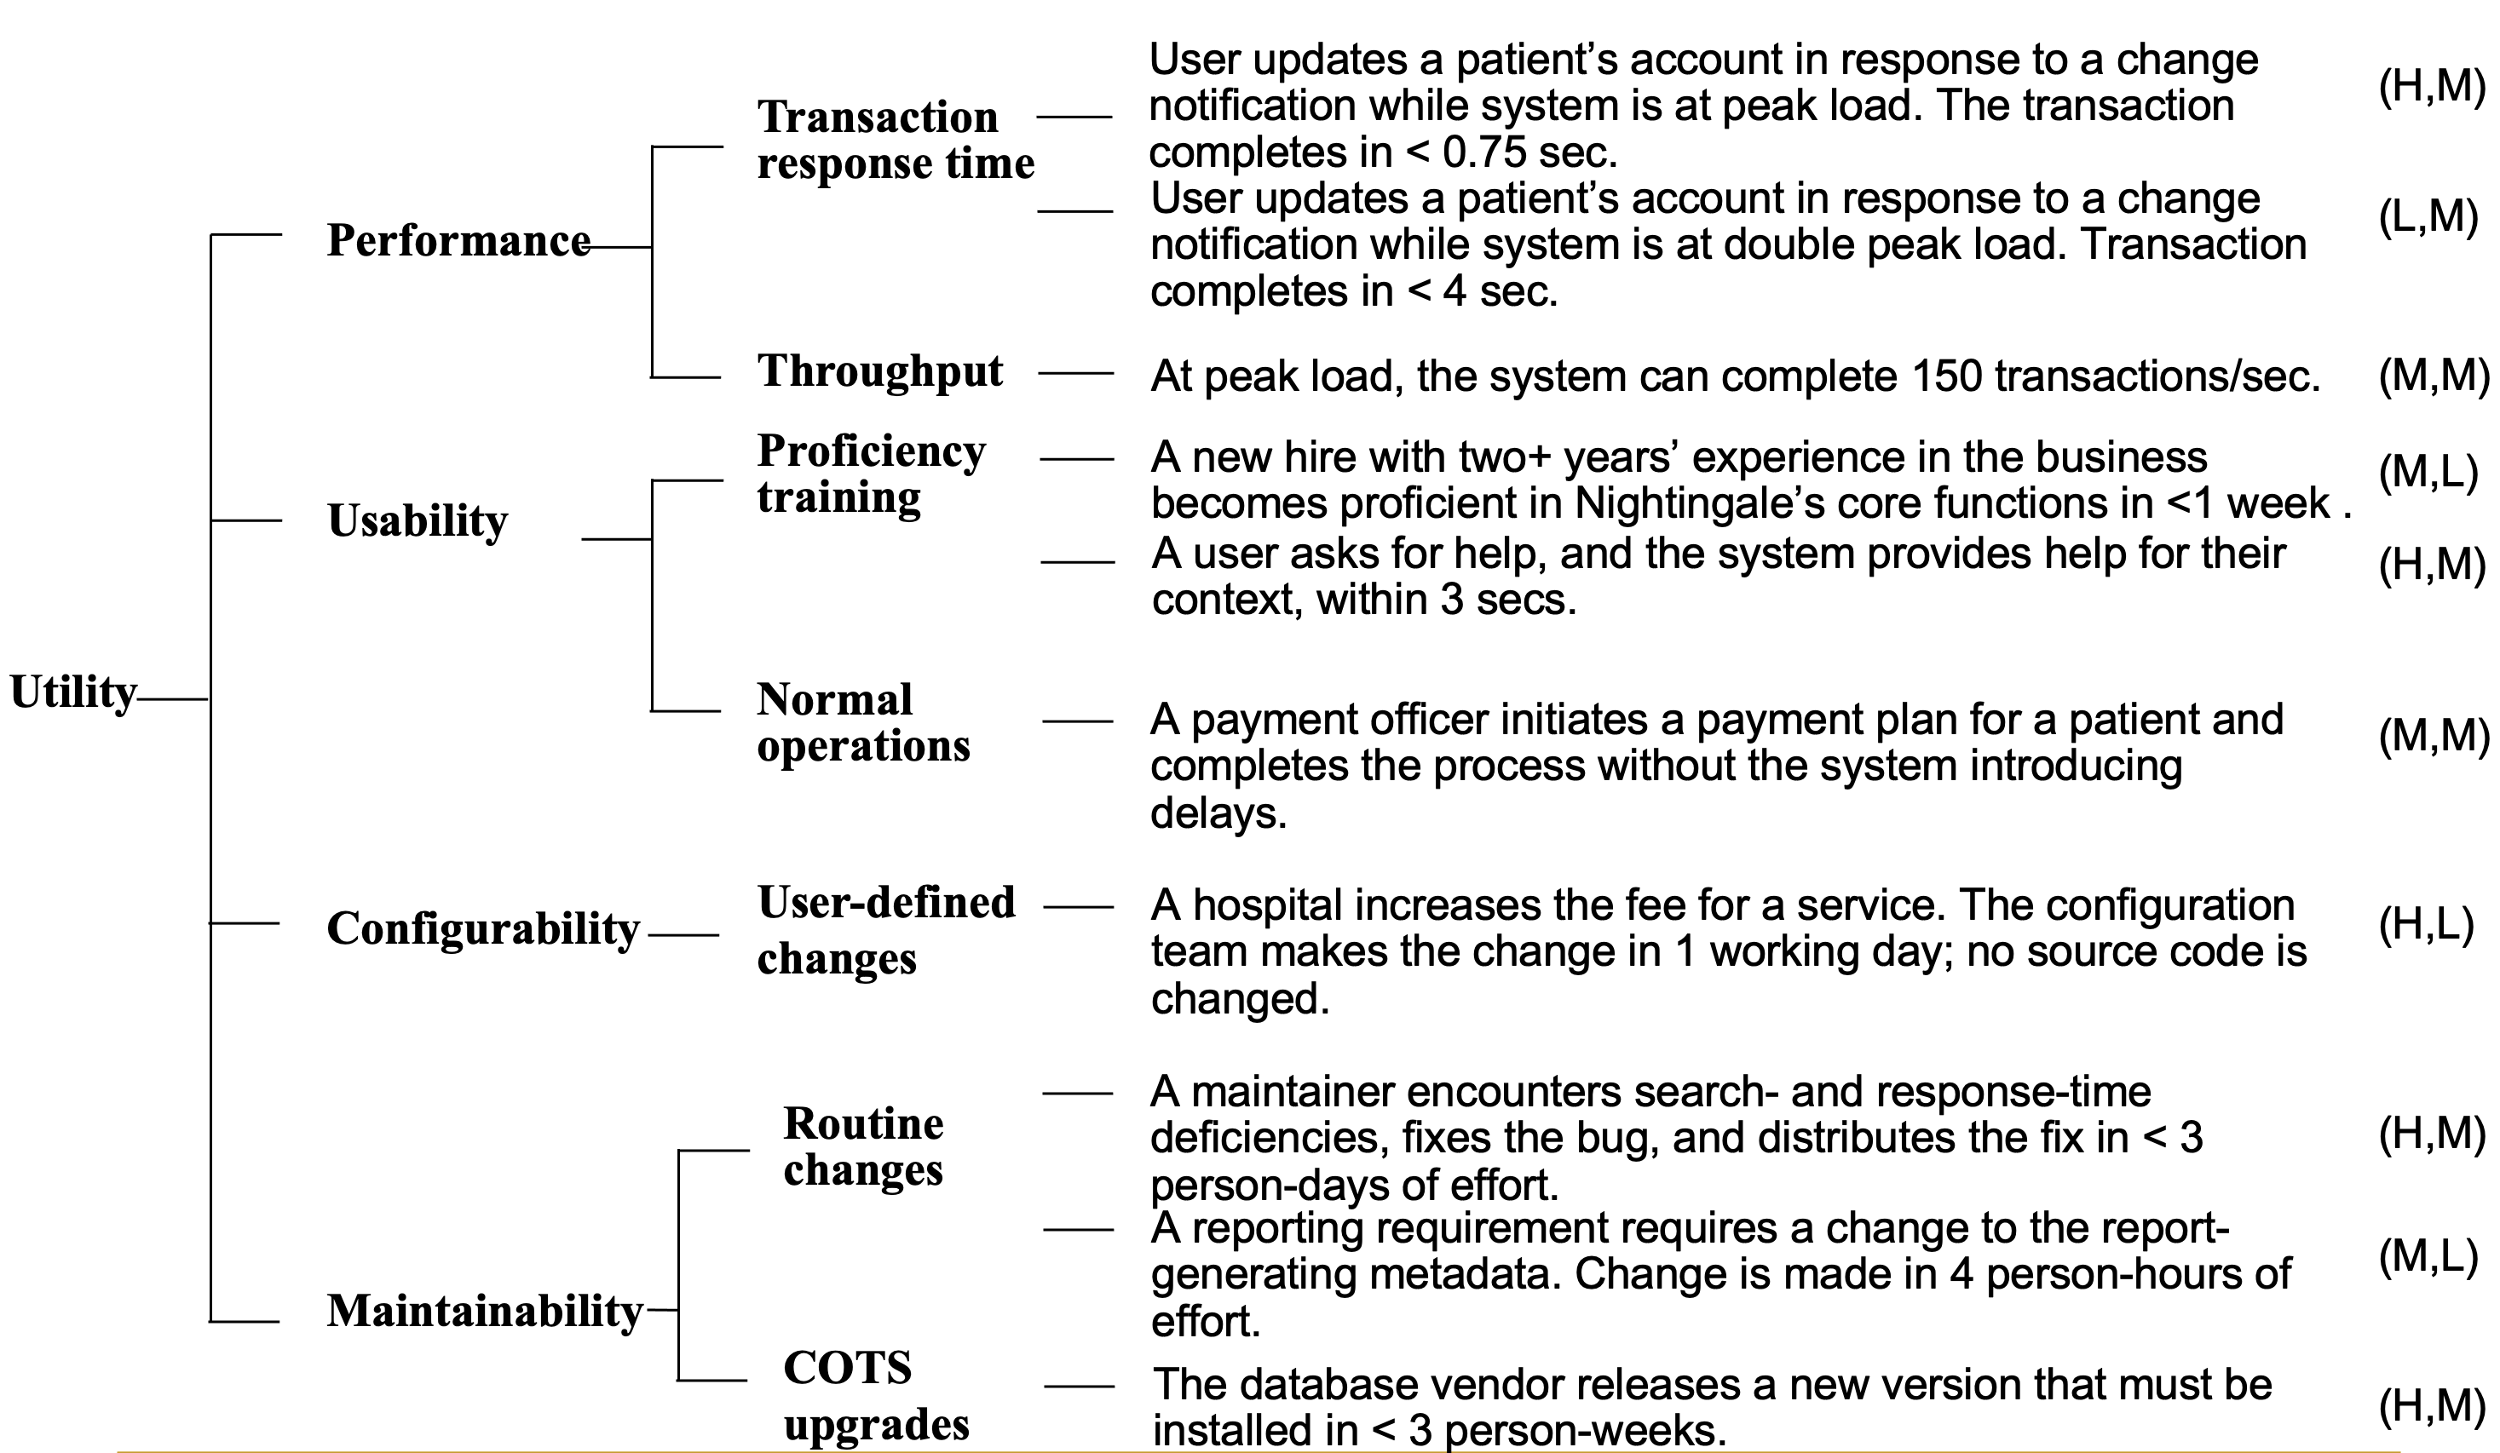
Example Utility Tree

Slide 14
Capturing ASRs in a Utility Tree
Once you have a utility tree filled out, you can use it to make important checks. For instance:
A QA without any ASR scenario is an area you should investigate.
ASR scenarios that receive a (H, H) rating are obviously the ones that deserve the most attention from you.

Slide 15
Change Happens
Requirements—whether captured or not—change all the time.
Architects have to adapt and keep up, to ensure that their architectures are still the right ones that will bring success to the project.
Always keep a channel open to the key stakeholders who determine the ASRs so you can keep up with changing requirements.

Slide 16
Summary
Architectures are driven by architecturally significant requirements. An ASR must have:
A profound impact on the architecture.
A high business or mission value.
ASRs can be extracted from a requirements document, captured from stakeholders during a workshop (e.g., a QAW), captured from the architect in a utility tree, or derived from business goals.

